Slide 1
HACKATHON 2014
July 16 2014
FSL Devils
Vasu Gupta (B45802)
Anshu Singh (B51212)

Slide 2
FSL Devils
We joined Freescale Semiconductors a month ago after graduating this May from Arizona State University (Computer Science).
Vasu Gupta (B45802) - PDM Business Analyst, IT
Anshu Singh (B51212) - Software Developer, CIM

Slide 3
Problem Statement
Location, Location, Location -- Which building is Building 20? What is the address of the Tianjin R&D facility? Where the heck is the Toucan conference room??? -- Reduce stress and frustration by helping Freescale employees easily navigate their way through unfamiliar locations.
Why?
Being new to the facility, we get lost all the time, we need a solution .
This application requires latest technology and we didn’t knew the technology – Great opportunity to learn.
The most important – “We love to code”.

Slide 4
Let’s show you what we Hacked - Demo
Notes:
Show conference room finding ability non W
Show conference room finding ability Keystone
Show people finding capability
Responsive layout: works across browsers and platforms and devices

Slide 5
Technical Stuff!
HTML5, JavaScript and CSS3. That’s it!
Why? Works on most browsers, platforms and devices.

Slide 6
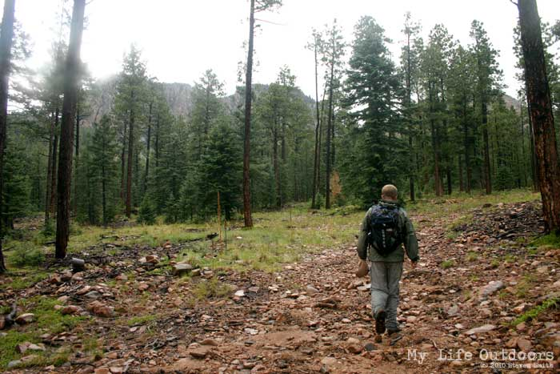
Scenario 1 – Help – I am Lost!!
Find a place and see it on map
Find your location
Find guided navigation to where you want to be.
Didn’t I just cross the cafeteria !!

Slide 7

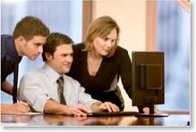
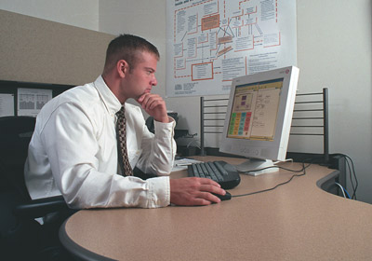

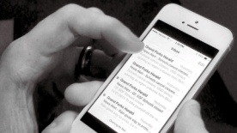
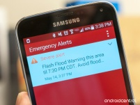
Scenario 2 – Setting up a meeting
Receives meeting request.
Calculates navigation path for each employee based on their location.
Sends it to their mobile as an alert and an email.
Cloud
Meeting invite in a conference room by an employee on the application.
Save it on the conference room calendar and notify admin for approval.

Slide 8
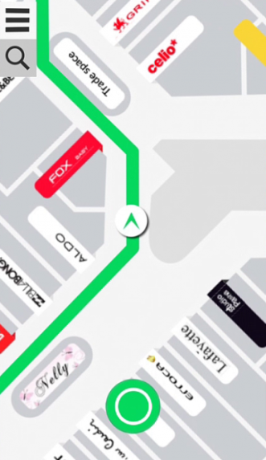


Scenario 3 – Emergency Preparedness
In case of an emergency like fire, the path to a relief area that you know is not viable.
Calculates viable path for each employee based on their location
Admin creates an alert for affected employees in case of emergency with all information about the situation.
Cloud
Emergency alert on all employee’s mobile and desktop devices.

Slide 9
Risks
Standard GPS doesn’t work inside building – take advantage of wi-fi.

Slide 10
Q & A! Feedback

